Slide 1
IRRIGATION
Definition & Types of Irrigation

Slide 2
What is Irrigation?
Irrigation is the replacement or supplementation of rainwater with another source of water.
Artificial means of Bringing water to land.

Slide 3
Ditch Irrigation
Ditch Irrigation is a rather traditional method, where ditches are dug out and seedlings are planted in rows. The plantings are watered by placing canals or furrows in between the rows of plants. Siphon tubes are used to move the water from the main ditch to the canals.

Slide 4
Terraced Irrigation
This is a very labour-intensive method of irrigation where the land is cut into steps and supported by retaining walls. The flat areas are used for planting and the idea is that the water flows down each step, while watering each plot. This allows steep land to be used for planting crops.

Slide 5
Drip Irrigation
This is known as the most water efficient method of irrigation. Water drops right near the root zone of a plant in a dripping motion. If the system is installed properly you can steadily reduce the loss of water through evaporation and runoff.

Slide 6
Sprinkler System
This is an irrigation system based on overhead sprinklers, sprays or guns, installed on permanent risers. You can also have the system buried underground and the sprinklers rise up when water pressure rises.

Slide 7
Rotary Systems
This method of irrigation is best suited for larger areas, for the sprinklers can reach distances of up to 100 feet. The word “Rotary” is indicative of the mechanical driven sprinklers moving in a circular motion, hence reaching greater distances. This system waters a larger area with small amounts of water over a longer period of time.

Slide 8
Centre Pivot Irrigation
This is a form of overhead irrigation. Steel or aluminium pipes are joined together, supported by trusses, mounted on wheeled towers. The sprinklers are situated on the length of the tower and they move in a circular motion.

Slide 9
Questions
Which one is a Irrigation system?
Garden System
PVC System
Sprinkler System
Watering System

Slide 10
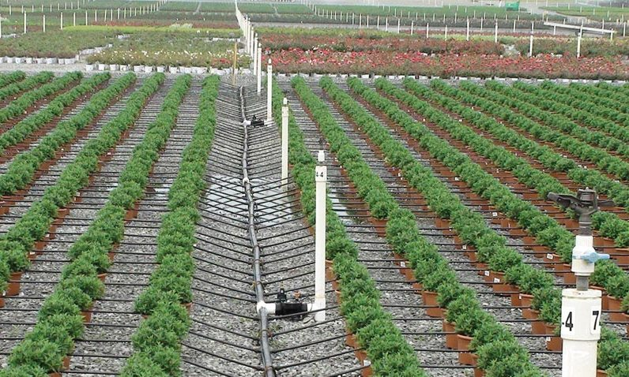
The images Below are what type of Irrigation Method?
Drip Irrigation
NEXT

Slide 11
Rotary System
NEXT

Slide 12
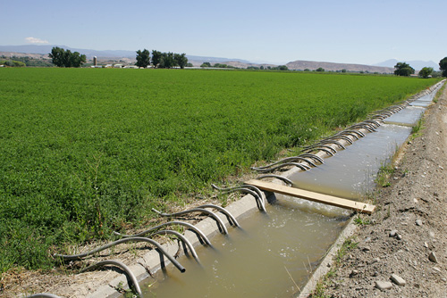
Ditch Irrigation
NEXT

Slide 13
Centre Pivot Irrigation
NEXT

Slide 14
Terraced Irrigation
NEXT

Slide 15
Sprinkler System
NEXT

Slide 17
GO BACK

Slide 18
NEXT

