Slide 1
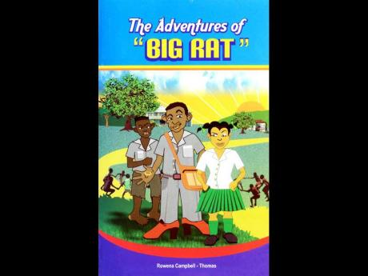
The Adventures of Big Rat
Week 2-3

Slide 2
Learning objectives:
Differentiate between themes and Characterization:
Discuss at least three themes evident in the novel :
Distinguish between direct and indirect characterization:
Complete activities related to themes and characterization:

Slide 3
What is A theme?
A literary theme is the main idea or underlying meaning a writer explores in a novel, short story, or other literary work. The theme of a story can be conveyed using characters, setting, dialogue, plot, or a combination of all of these elements.

Slide 4
Examples of Themes
Six common themes in literature are:
Good vs. evil
Love
Redemption
Courage and perseverance
Coming of age
Revenge
NB: Theme is defined as a main idea or an underlying meaning of a literary work, which may be stated directly or indirectly.

Slide 5
Themes In the Adventures of Big Rat
Love and family relationship
Abuse
Determination
Poverty
Activity : Examine the themes above and write a paragraph on how each theme is evident in the novel.

Slide 6
Defining Characterization
. Characterization is the process by which the writer reveals the personality of a character. Characterization is revealed through direct characterization and indirect characterization.

Slide 7
Examples of Characterization
The way a character speaks can inform us of their background and personality, like how educated they are, or what they consider to be important. Even the way other characters speak to and about our characters is a form of characterization.
Example 1
In the Harry Potter series, Dobby refers to Potter as “the noble Harry Potter,” or “good Harry Potter,” which shows us how the house elf adores the young wizard. It might also be a hint of how Dobby would show affection for other people he admires.

Slide 8
Types of Characterization
Direct Characterization tells the audience what the personality of the character is. Example: “The patient boy and quiet girl were both well mannered and did not disobey their mother.” Explanation: The author is directly telling the audience the personality of these two children. The boy is “patient” and the girl is “quiet.”

Slide 9
Types of characterization
https://www.youtube.com/watch?v=-ZnD0AGqQ7I

Slide 10
Activity 2
Identify 10 characters from the novel and write adjectives to describe them. In your descriptions, state whether direct or indirect characterization was employed by the author in order for you to draw this conclusion.

